Slide 1

DMET 1067 Deep Learning in Computer Vision For junior graduate students
Academic Year 2020/2021, Spring Semester
Dr. Mohammed A.-Megeed Salem
Associate Professor, Media Engineering Technology,
German University in Cairo

Slide 2
Team Members
Nada Labib 40-0876
Nadine Moustafa 40-8087
Youssr Abou-Youssif 40-9369
Yomna El-Shazly 40-2724
Aya Bedwi 40-0731

Slide 3
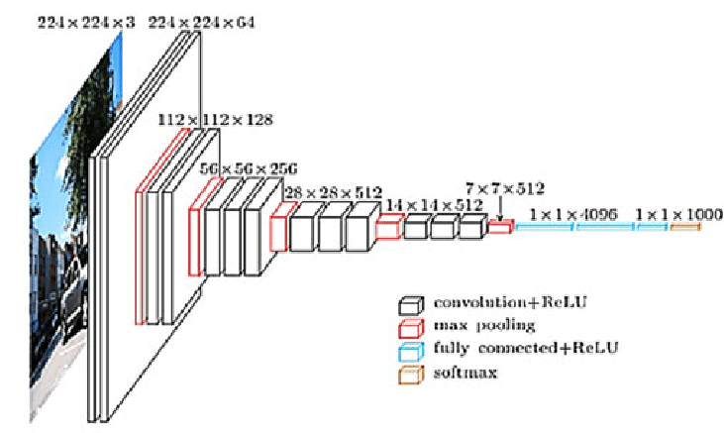
CNN for Action Recognition

Slide 4
Overview of the project
In this project, we choose vgg16 deep learning model to perform the proposed topic which is CNN for action recognition.
It recognizes different actions from multiple images that have been taken from a video sequence.
So that, it is an image classification task by making the classification labels are the different actions that people perform.

Slide 5
Input to the Model
Sequence of images for each action.
We have 11 different actions that can be classified from images

Slide 6
Create Dataset
Create CSV file includes all the 2750 images for all classes.
Give specific label for each image corresponds to what class it belongs.

Slide 7
Dataset
A video film that have been taken its frames for each second in the film corresponds to 25 frames/ images.
The film results in 160,000 image and then we choose the most accurate images for each action that describes this action specifically.
Finally we take 250 different images for each action

Slide 8
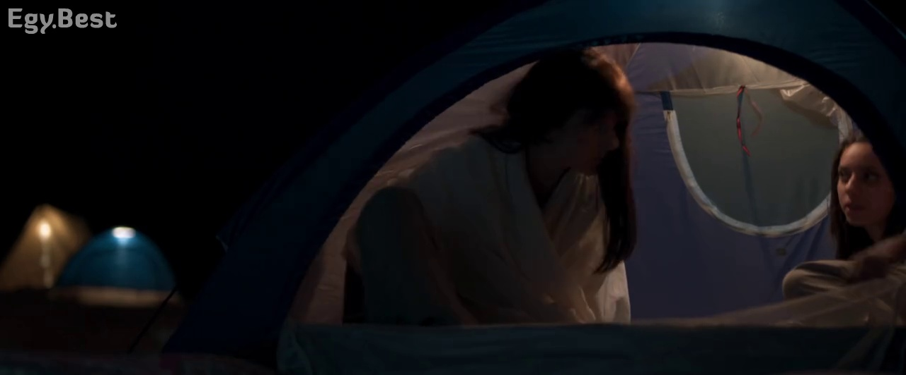
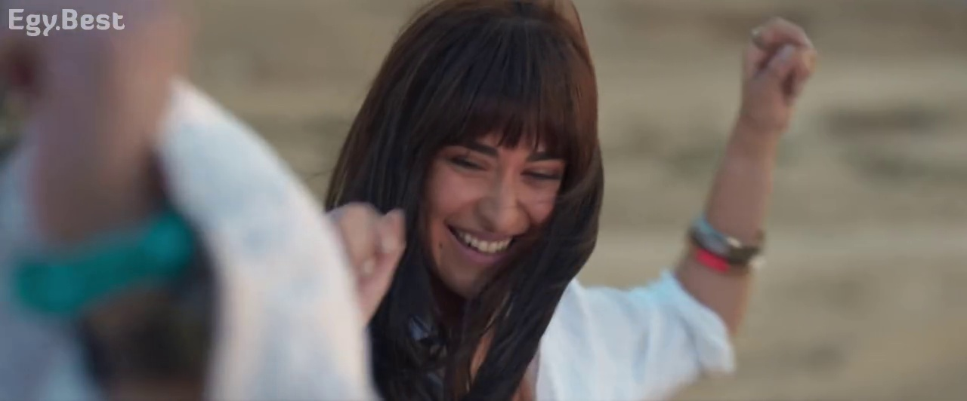
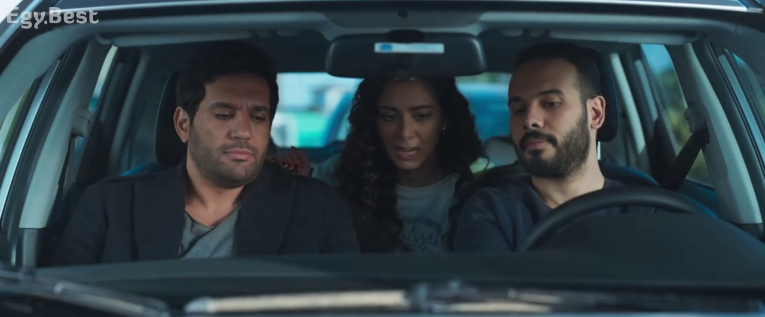
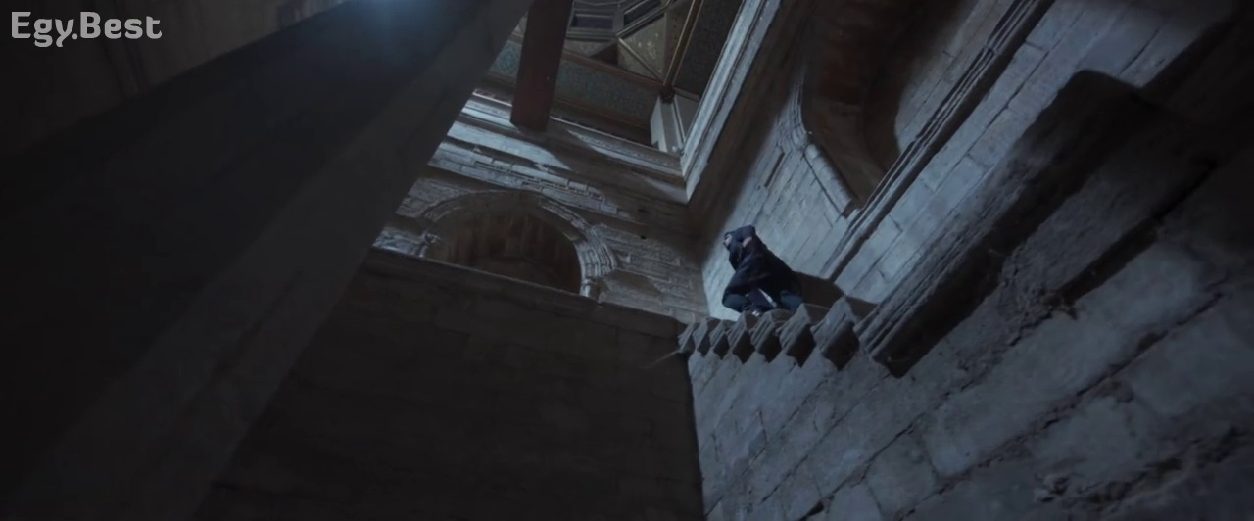
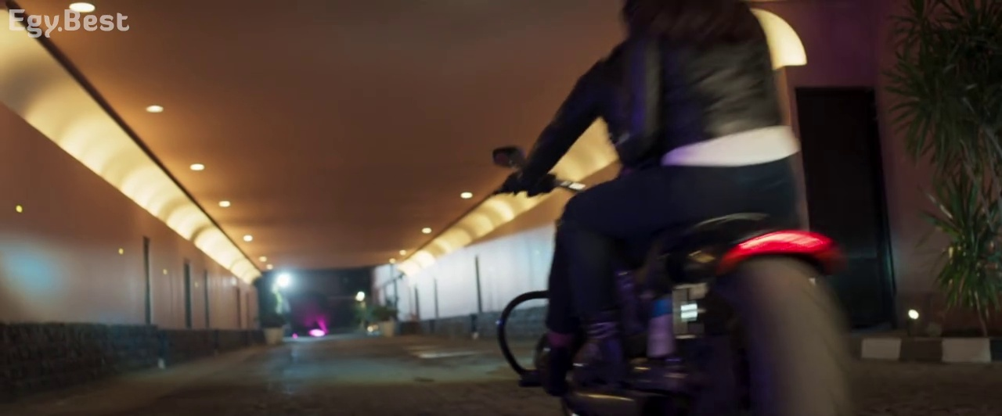
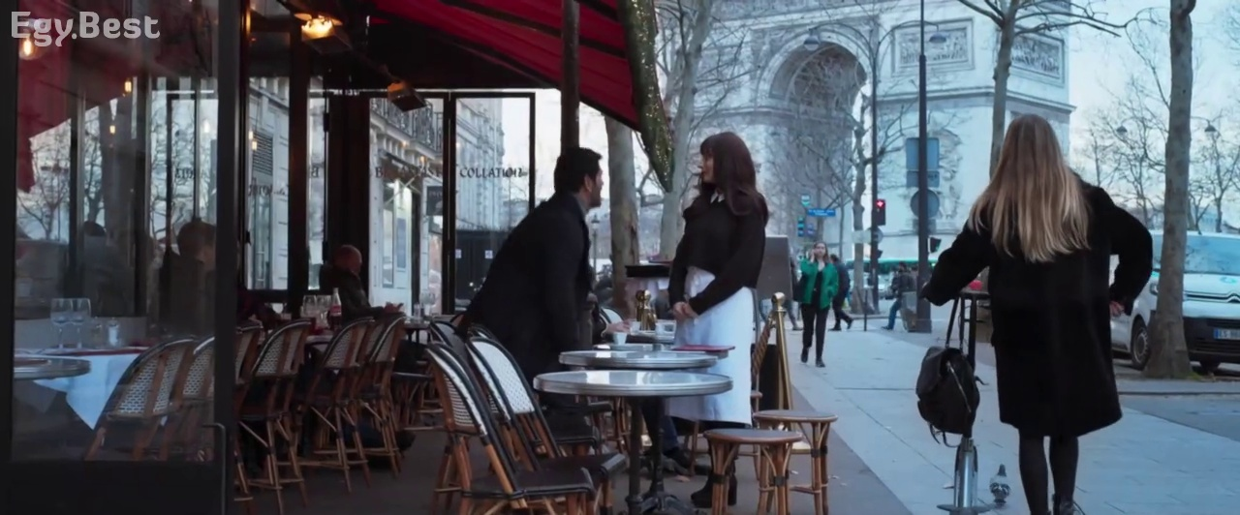
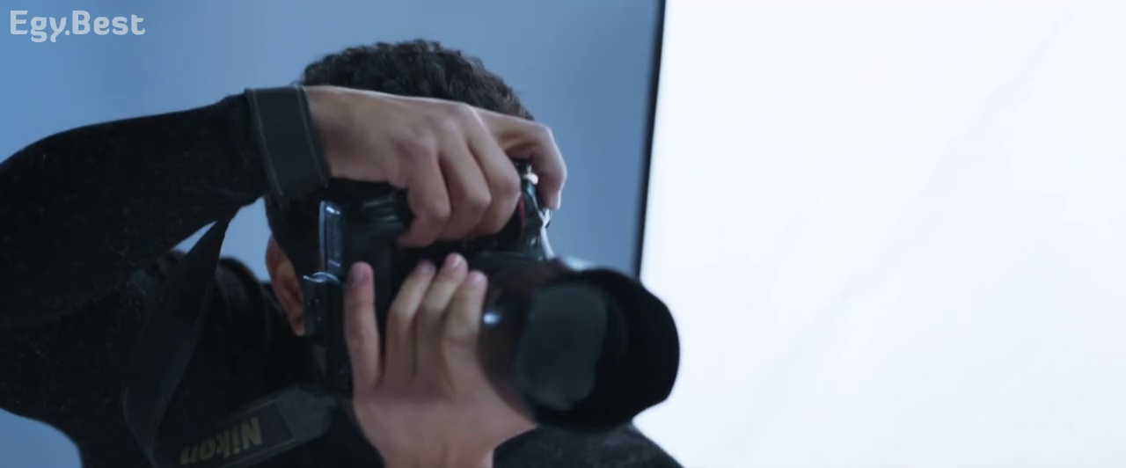
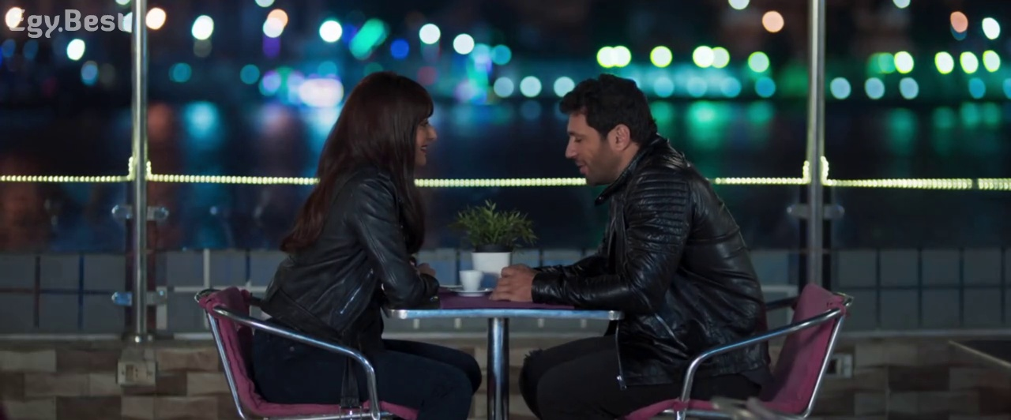
Sample of the Dataset
Camping
Dancing
Drive a car
Going down
Drive Motor
Order Food
Photograph
Sit and talk

Slide 9
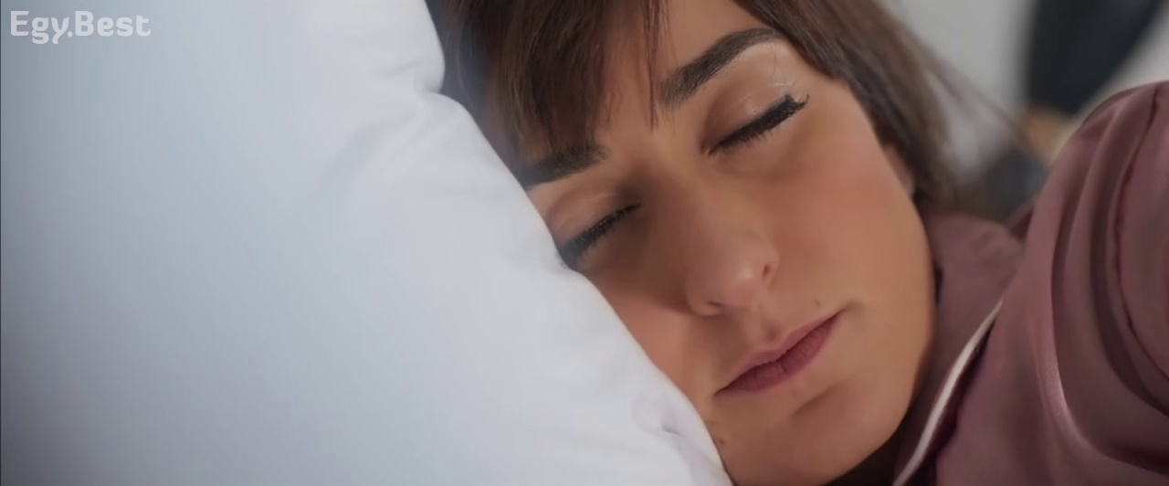
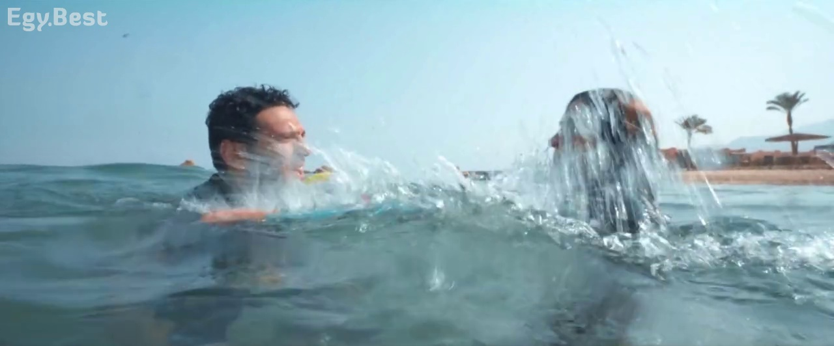
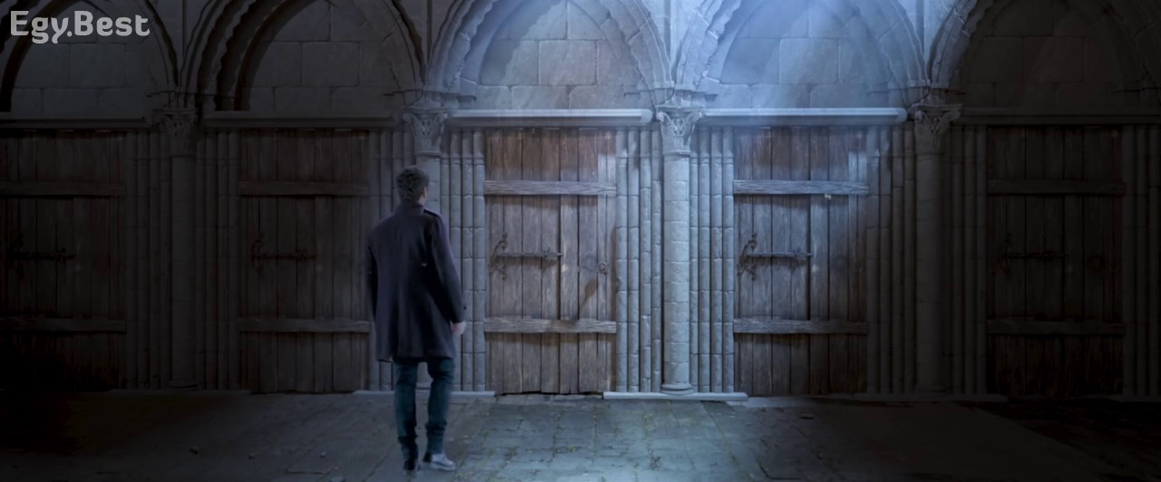
Sample of the Dataset
Sleeping
Swimming
Walking

Slide 10
Actions Classified
Driving a car
Sleeping
Dancing
Walking
Sitting and talking
Going downwards
Swimming
Photography
Camping
Driving a Motor
Order food

Slide 11
VGG16 Model
VGG16 is a convolution neural net (CNN) architecture which was used to win (ImageNet) competition.
Most unique thing about VGG16 is that instead of having a large number of hyper-parameters they focused on having convolution layers of 3x3 filter with a stride 1 and always used same padding and maxpool layer of 2x2 filter of stride 2.

Slide 12
Reading the Dataset
We create a csv file with number of rows equals to the number of images so, it includes 2750 row.
For each 250 rows we give them a specific label corresponds to the image action type, so we give it a string label describes the action.
A number also indicates a label for this specific action.

Slide 13
Model
Start by building the VGG16 model.
Reading the training images.
Train the model over the images.
Training model with 3 channels, 16 batch size and 10 epochs.
Use softmax activation function.
Use the SGD optimizer.
Apply the fine tunning.
Calculate the loss entropy score.

Slide 14
Model
Starting by importing the needed libraries to implement vgg16 model
Looping over the csv file created to take the labels and save them together with the images in a train folder for training the model.
Method that creates vgg16 model which starts by initializing the model by make it pretrained over ImageNet and include the 3 fully connected layers on the top of the network.
Use the SoftMax activation function over the model output layers.
Setting the first 8 layers of the model to non-trainable which means that the weights are not updated.
Using the SGD “Stochastic gradient descent” optimizer which is an iterative method to optimize objective functions.
Do the fine tuning, making the predictions and calculate the loss entropy score.
Start training the model over 3 channels, 16 batch size and 10 epochs.

Slide 15
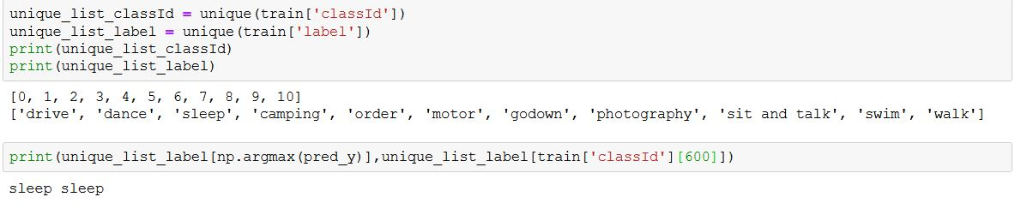
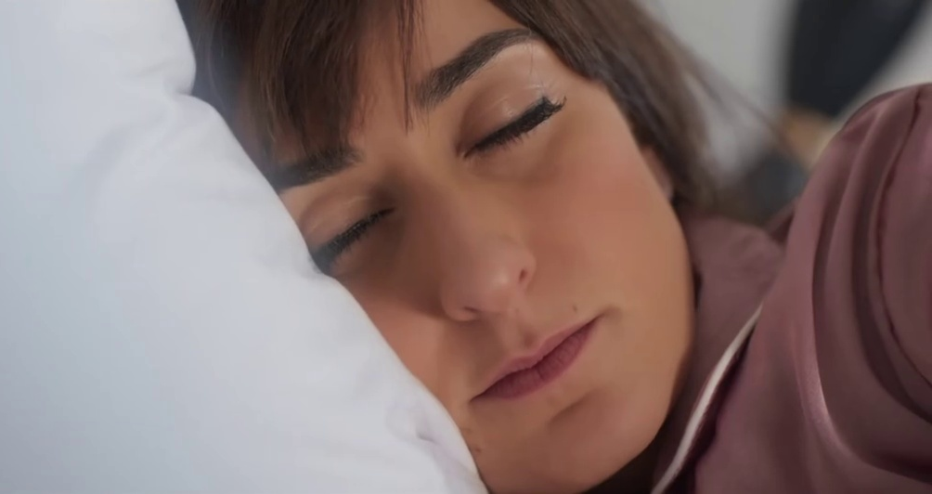
Output

Slide 16
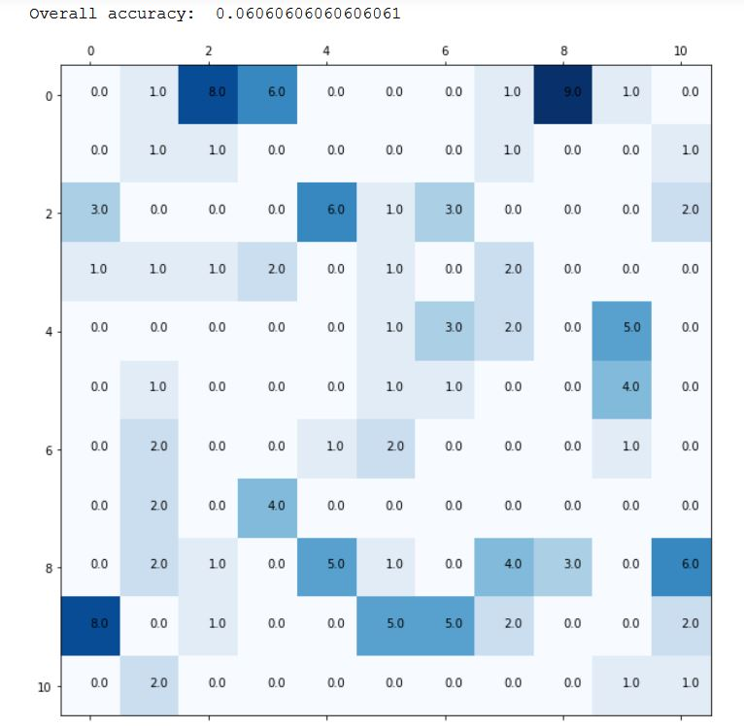
Confusion Matrix

Slide 17

Thank You

Slide 18
Contacts
Deep Learning in Computer Vision, for junior graduate students,
Spring Semester 2021, Media Engineering Technology,
German University in Cairo(GUC)
Dr. Mohammed Abdel-Megeed M.Salem
Office: C7.311
Tel: +2 011 1727 1050
Email: mohammed.salem@guc.edu.eg

